Slide 1

contact@softyeducation.com

Slide 2
Day 3

Slide 3
Content :
Strings
Integers
Floating-Point Numbers
Arithmetic Operators
Arithmetic Expressions

Slide 4

01
Strings

Slide 5

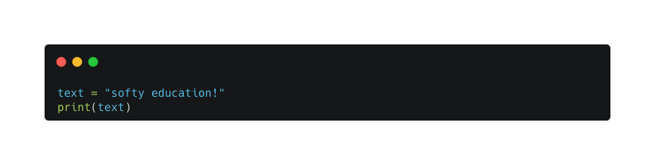
01- Strings
Strings are a basic type of data in Python used to represent text. In Python, data types determine what kind of information a value holds, and strings are specifically used for working with text.
‹#›

Slide 6
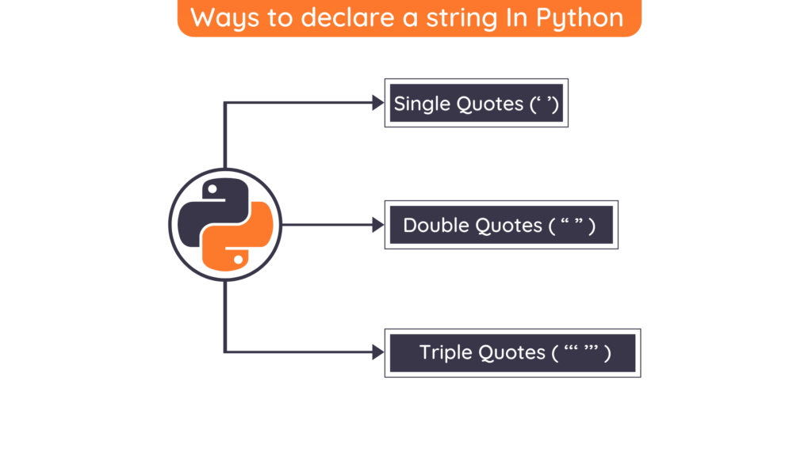
01- Strings
‹#›

Slide 7
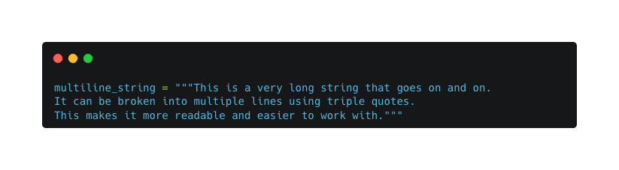
01- Strings
Multiline Strings
When dealing with long strings in your code, you can make them more manageable by breaking them up into multiple lines using a multiline string. Here's an example in Python:
‹#›

Slide 8
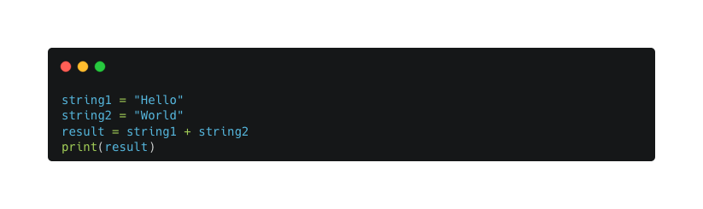
01- Strings
String Concatenation
To combine two strings, you can use the + operator. Here's an example:
‹#›

Slide 9
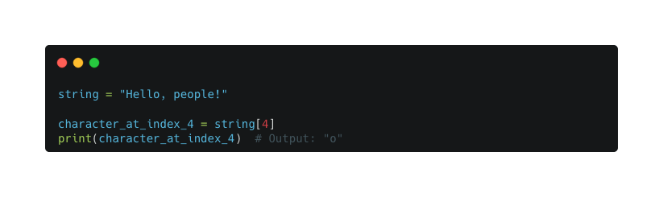
01- Strings
String Indexing
In a string, each character is assigned a numbered position known as an index. To access the character at a specific position (N), you can use square brackets ([ and ]) right after the string. Here's an example code snippet:
‹#›

Slide 10
01- Strings
String Indexing
In a string, each character is assigned a numbered position known as an index. To access the character at a specific position (N), you can use square brackets ([ and ]) right after the string. Here's an example code snippet:
‹#›

Slide 11
02
Integers

Slide 12
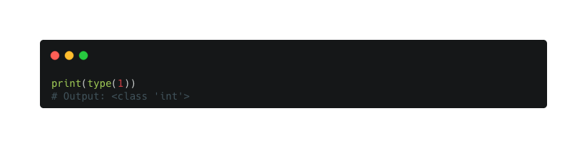
02- Integers
An integer is a whole number without any decimal places. For example, 1 is an integer, but 1.0 is not. We call this data type "int." To check the data type of a value, you can use the type() function.
‹#›

Slide 13
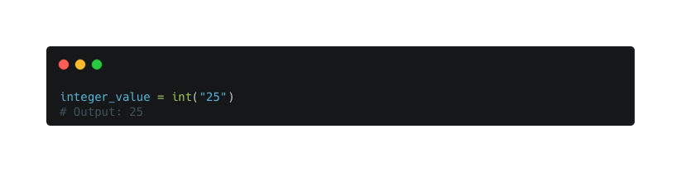
02- Integers
To create an integer, you can simply type the number explicitly. Alternatively, you can use the int() function to convert a string containing an integer into an integer value. For instance:
‹#›

Slide 14
03
Floating-Point Numbers

Slide 15
03 - Floating-Point Numbers
A floating-point number, also called a "float" for short, is a number that has a decimal place. For example, 1.0 and -2.75 are floating-point numbers. The data type used to represent floating-point numbers is called "float."
‹#›

Slide 16
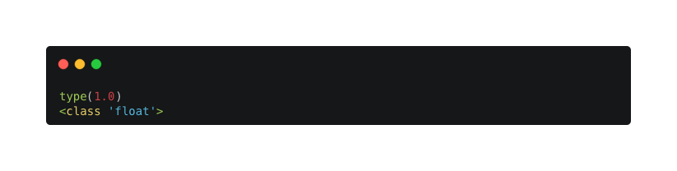
03 - Floating-Point Numbers
You can check the type of a value using the type() function. When you do this with the value 1.0, it will show that it is of the float type.
‹#›

Slide 17
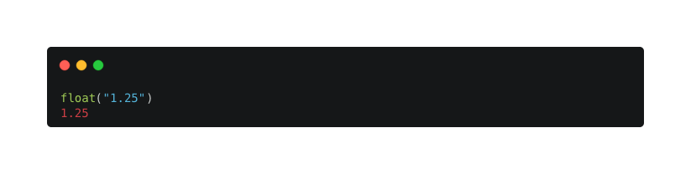
03 - Floating-Point Numbers
To create a floating-point number in your code, you can simply type the number directly. Alternatively, you can use the float() function to convert a number stored as a string into a floating-point number.
‹#›

Slide 18
04
Arithmetic Operators

Slide 19
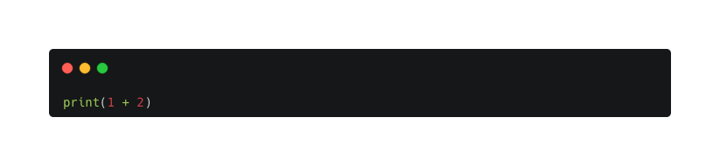
04 - Arithmetic Operators
Addition
Addition is performed with the + operator:
The two numbers on either side of the + operator are called operands.
In the previous example, both operands are integers, but operands do
not need to be the same type.
‹#›

Slide 20
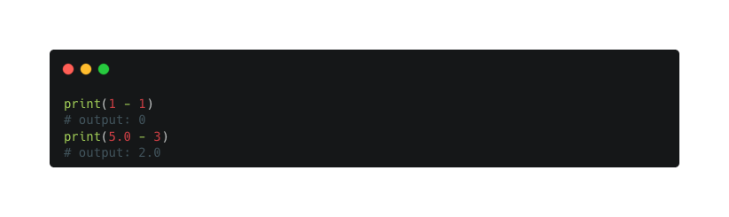
04 - Arithmetic Operators
Subtraction
To subtract two numbers, just put a - in between them:
Just like adding two integers, subtracting two integers always results in an int. Whenever one of the operands is a float, the result is also a float.
‹#›

Slide 21
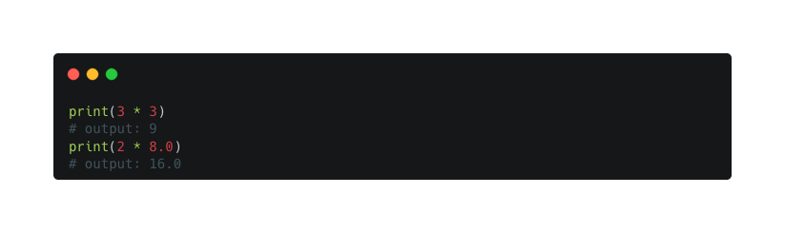
04 - Arithmetic Operators
Multiplication
To multiply two numbers, use the * operator:
The type of number you get from multiplication follows the same rules as addition and subtraction. Multiplying two integers results in an int, and multiplying a number with a float results in a float
‹#›

Slide 22

04 - Arithmetic Operators
Division
The / operator is used to divide two numbers:
Unlike addition, subtraction, and multiplication, division with the / operator always return a float. I
‹#›

Slide 23
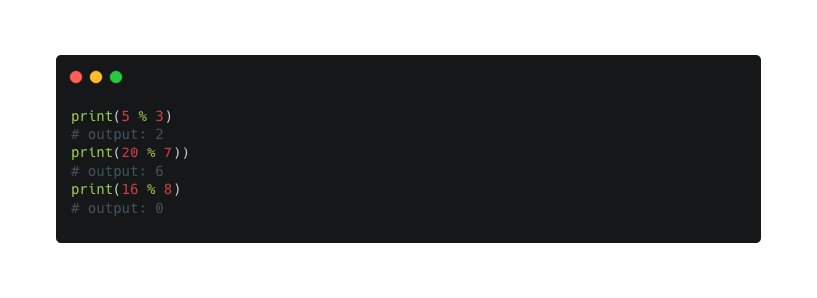
04 - Arithmetic Operators
The Modulus Operator
The % operator, or the modulus, returns the remainder of dividing the left operand by the right operand:
‹#›

Slide 24
05
Arithmetic Expressions

Slide 25
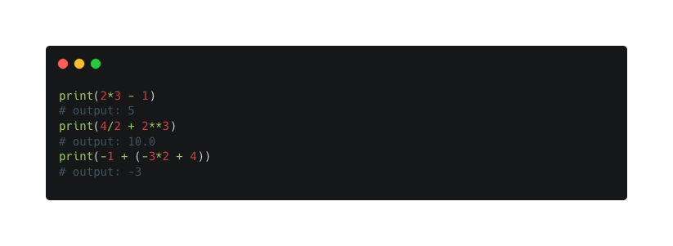
05 - Arithmetic Expressions
You can combine operators to form complex expressions. An expression is a combination of numbers, operators, and parentheses that Python can compute, or evaluate, to return a value.
‹#›

Slide 26
05 - Arithmetic Expressions
The rules for evaluating expressions work are the same as in every- day arithmetic. In school, you probably learned these rules under the name “order of operations.”
The *, /, //, and % operators all have equal precedence, or priority, in an expression, and each of these has a higher precedence than the + and - operators. This is why 2*3 - 1 returns 5 and not 4. 2*3 is evaluated first, because * has higher precedence than the - operator.
‹#›

Slide 27
06
Exercises

Slide 28
05- Exercises
Strings Methods
Exercise 1.1: Write a program that takes a string from the user and prints it in upper case.
Exercise 1.2: Write a program that takes a string from the user and prints its length.
Exercise 1.3: Write a program that takes a string and replaces all occurrences of a certain letter (e.g., 'a') with another letter (e.g., 'b').
‹#›

Slide 29
05- Exercises
Integers Methods
Exercise 2.1: Write a program that converts an integer to a string and prints its type before and after conversion.
Exercise 2.2: Write a program that takes two integers from the user and prints their absolute difference.
Exercise 2.3: Write a program that demonstrates using the divmod function with two integer inputs.
‹#›

Slide 30
Thank you

